Slide 1
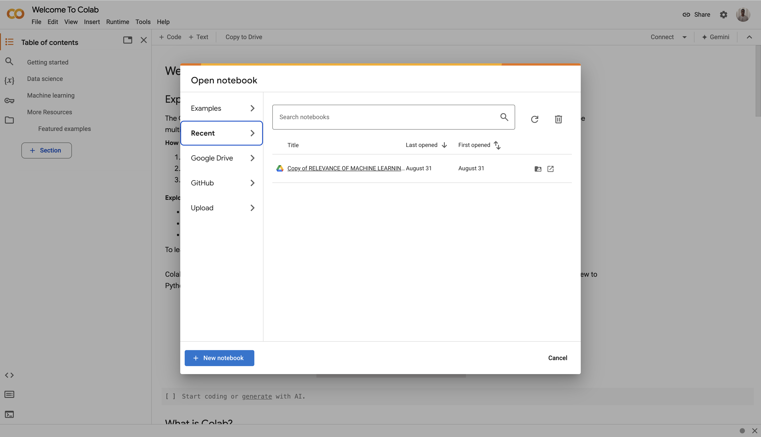

Getting Started with Google Colab for Machine Learning
Abdulhameed Yunusa

Slide 2
Outline
Introduction to Google Colab
How to connect to Google Drive
Setting up the environment
Downloading and using a pre-trained object detection model
Creating a practical object detection pipeline
Common issues and solutions

Slide 3
Introduction to Colab
What is Google Colab?
Free cloud-based Jupyter notebook environment
No setup required - runs in your browser
Free access to GPUs and TPUs
Perfect for machine learning and deep learning projects
Prerequisites
Google account
Basic Python knowledge
Internet connection
Roboflow account (free)

Slide 4
Getting Started with Google Colab
Accessing Google Colab
Go to colab.research.google.com
Sign in with your Google account
Create a new notebook: File → New Notebook

Slide 5

Creating a New Notebook
New notebook

Slide 6
Connecting to Google Drive
from google.colab import drive
drive.mount('/content/drive')
# Verify connection
!ls "/content/drive/My Drive"

Slide 7
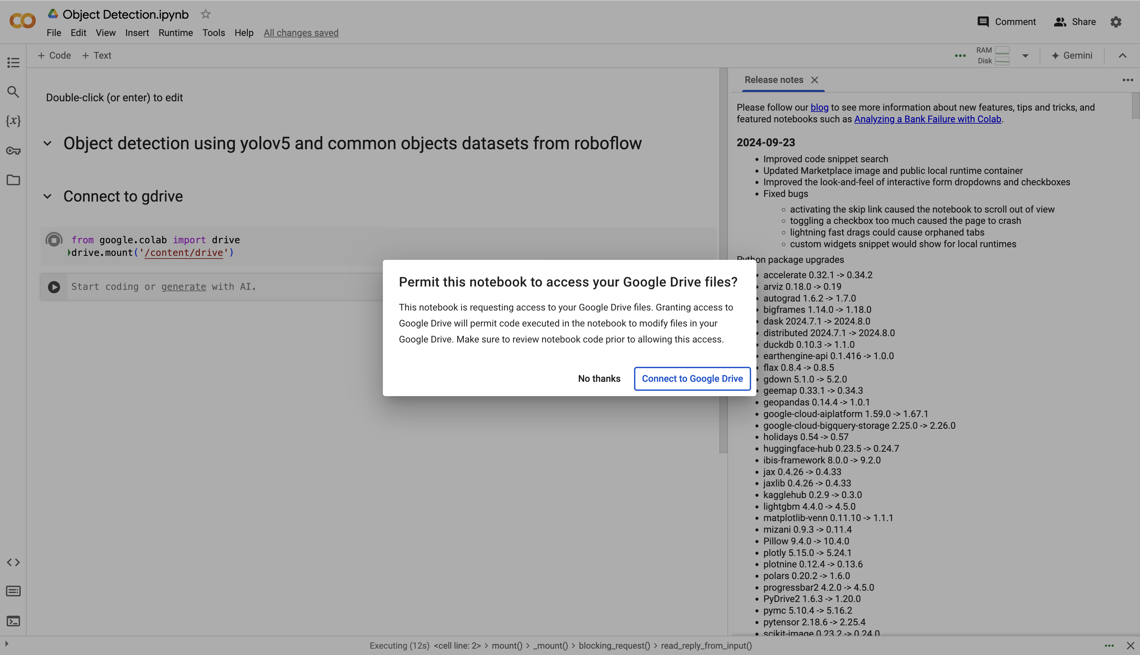
Connecting to Google Drive
Grant access to gdrive

Slide 8
Part 2: Setting Up Roboflow
Getting Your Roboflow API Key
Create a Roboflow Account:
Go to roboflow.com
Click "Sign Up" (or "Sign Up Free")
You can sign up with Google, GitHub, or email
Access Your API Key:
Log into your Roboflow account
Select "Settings" from left sidebar
Navigate to the "API Key" section
Click "Create New API Key" if you don't have one
Give your key a name (e.g., "Colab Project")
Copy the generated API key

Slide 9
Part 2: Setting Up Roboflow (Cont.d)
3. Best Practices for API Key Usage:
Never share your API key publicly
In Colab, you can store it as a secret:

Slide 10
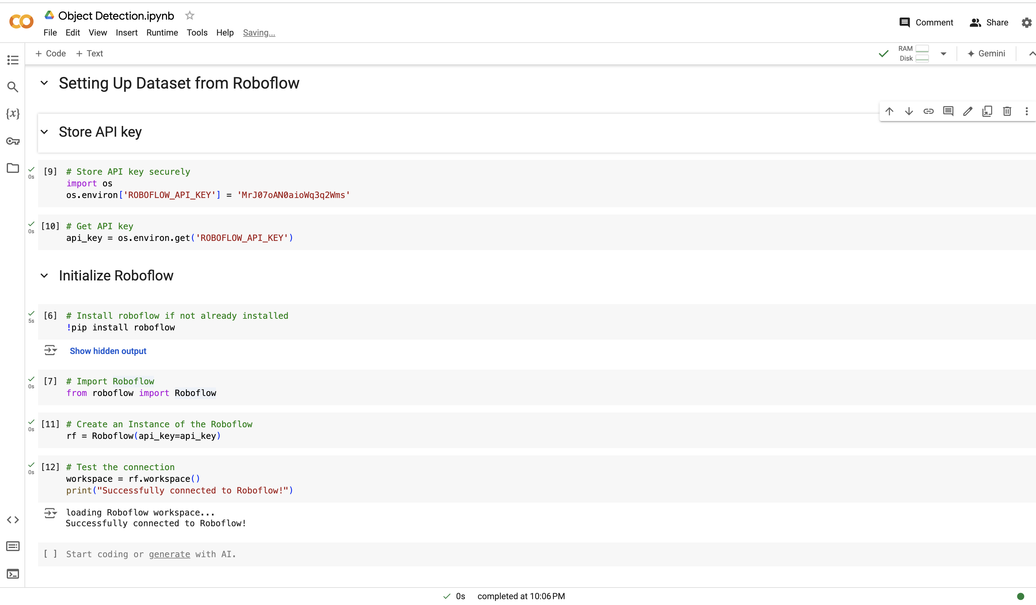
Part 2: Setting Up Roboflow (Cont.d)

Slide 11
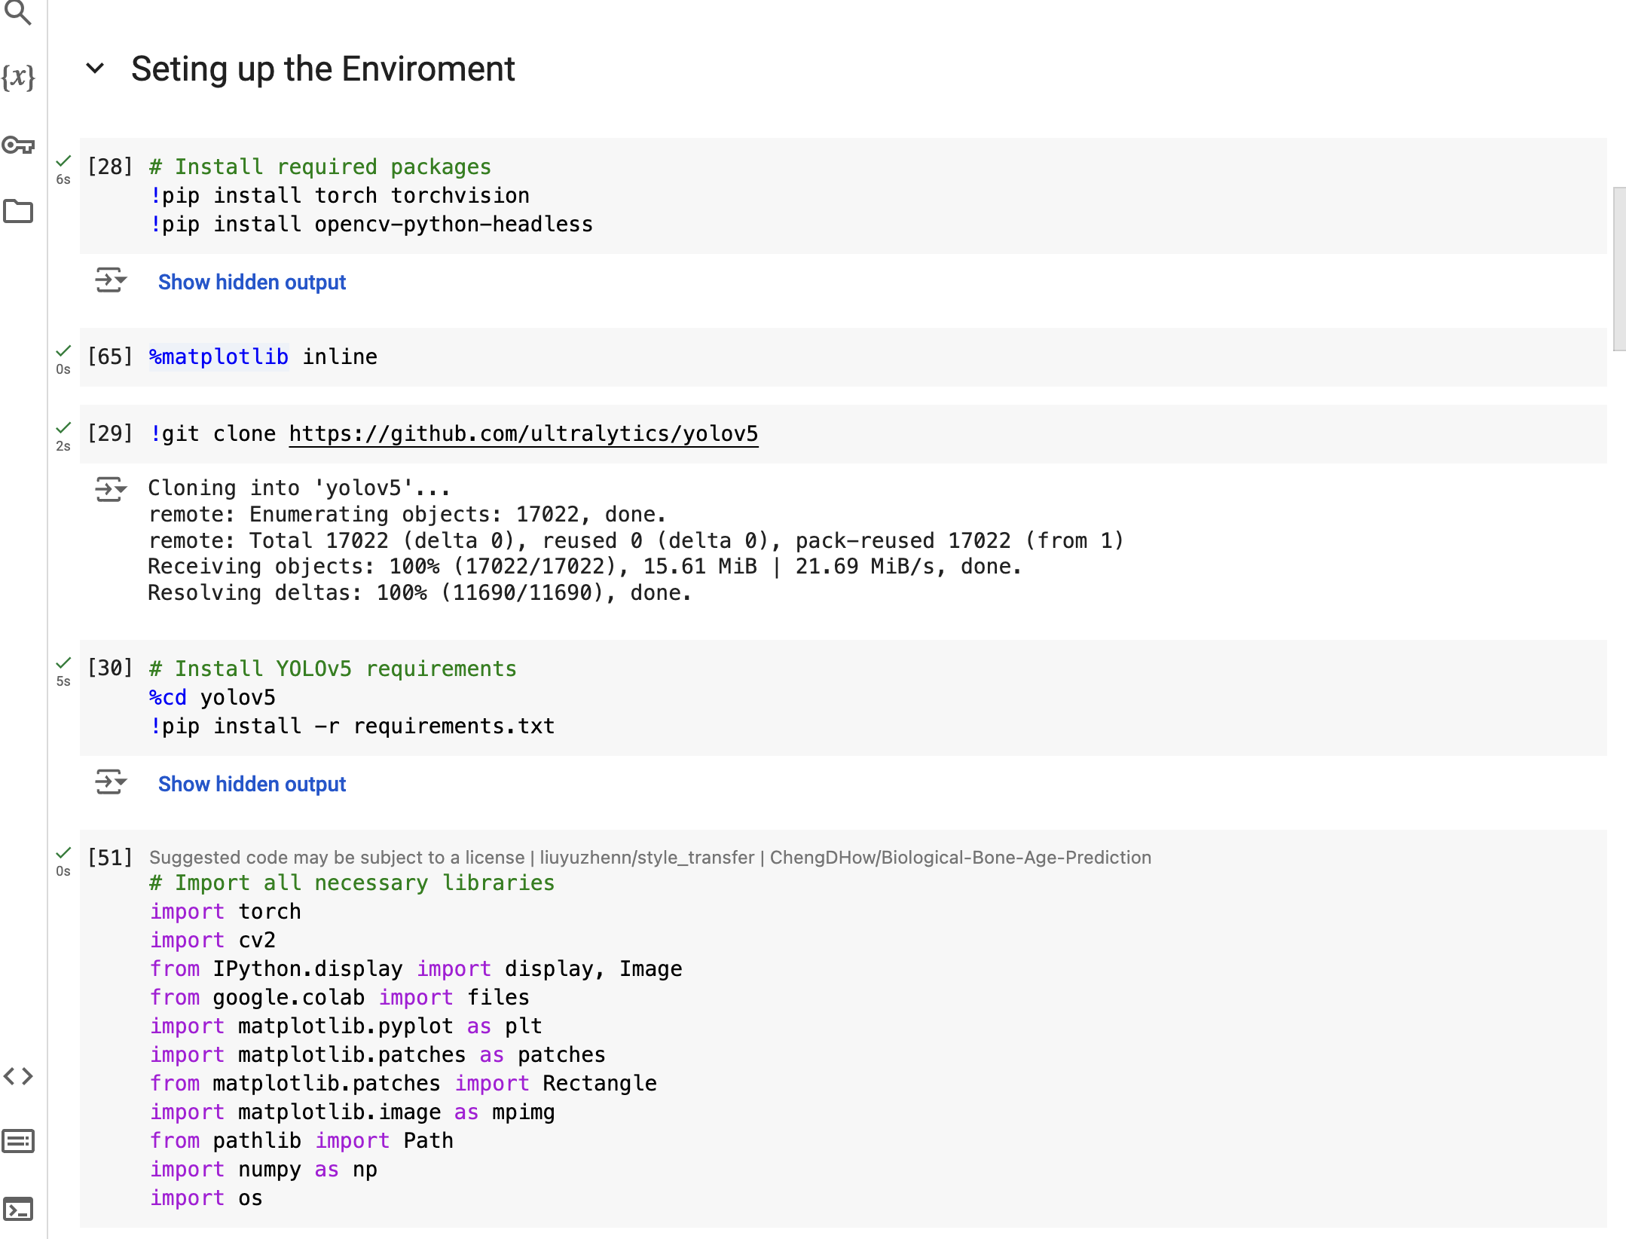
Part 3: Setting Up the Environment

Slide 12
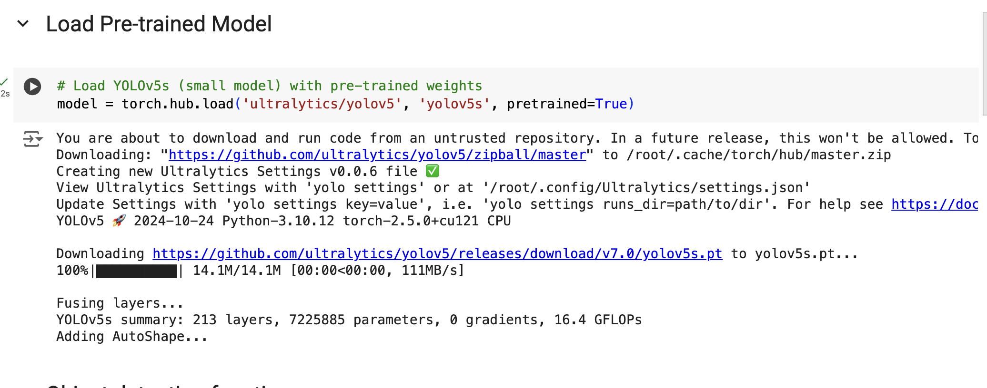
Load Pre-trained Model

Slide 13
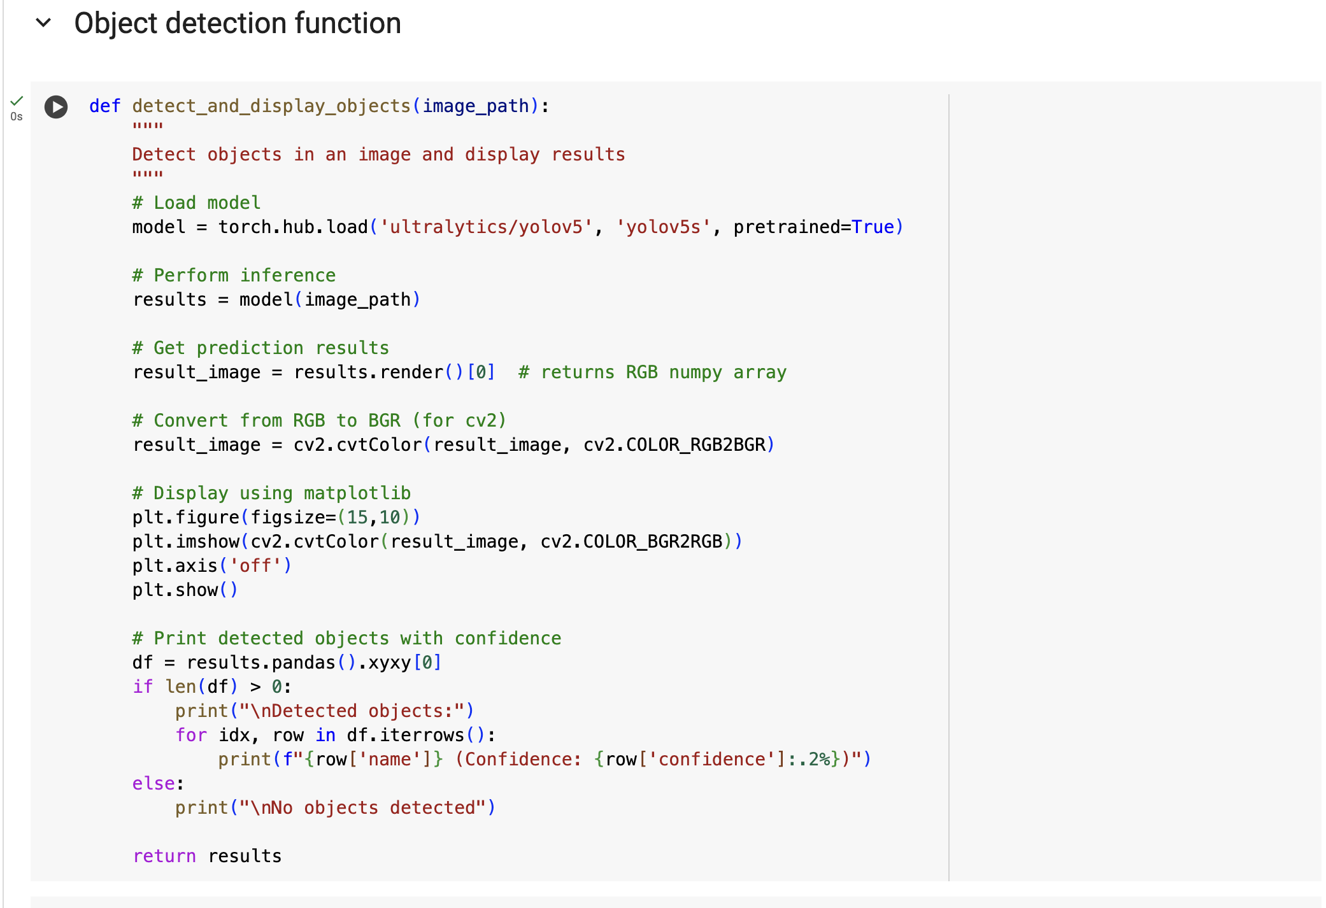
Object Detection Method

Slide 14
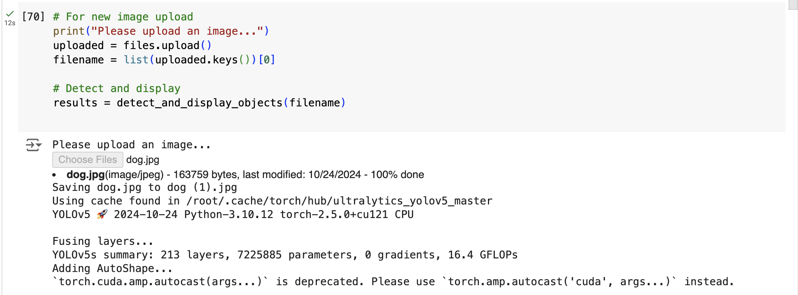
Using the Object Detection Method

Slide 15
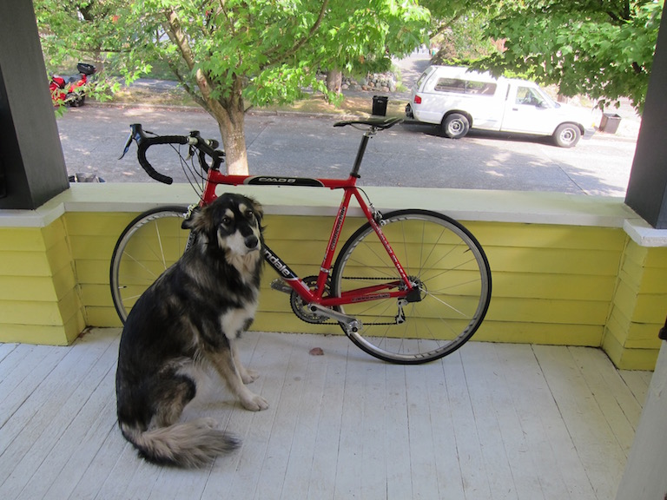
Test Image

Slide 16
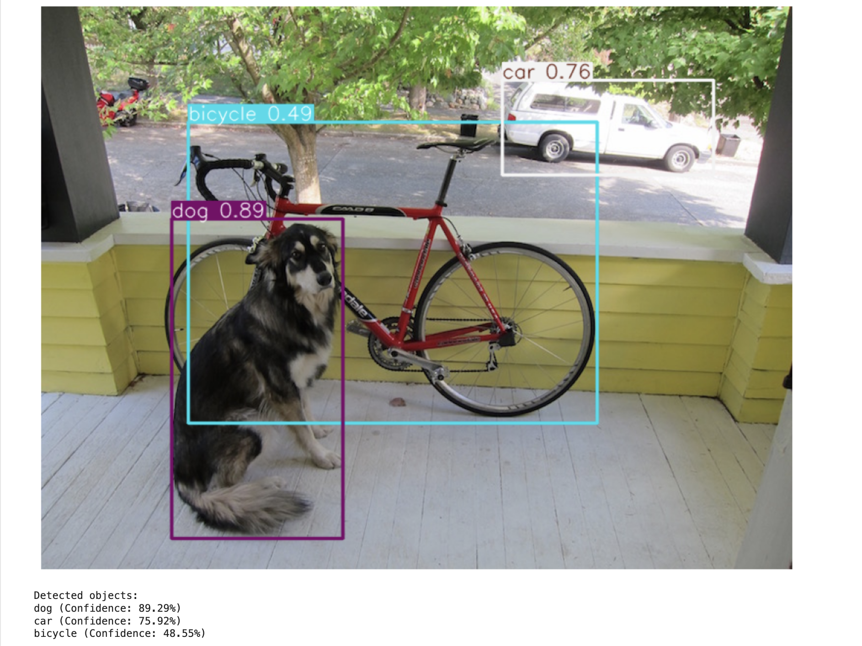
Object Detection

Slide 17
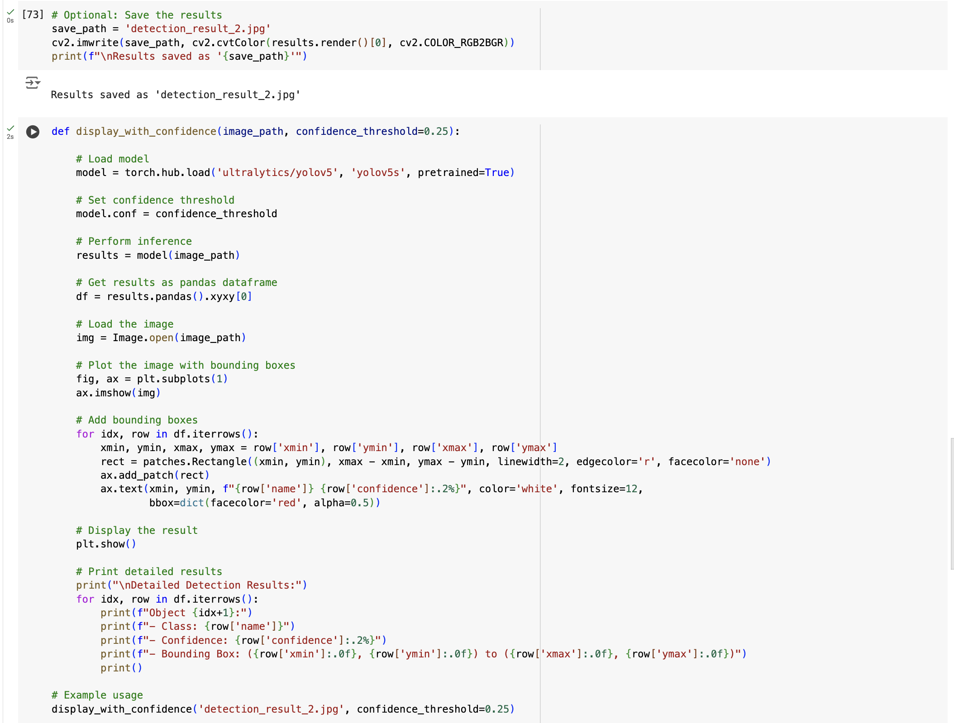
Save image and run prediction on Image Detection

Slide 18
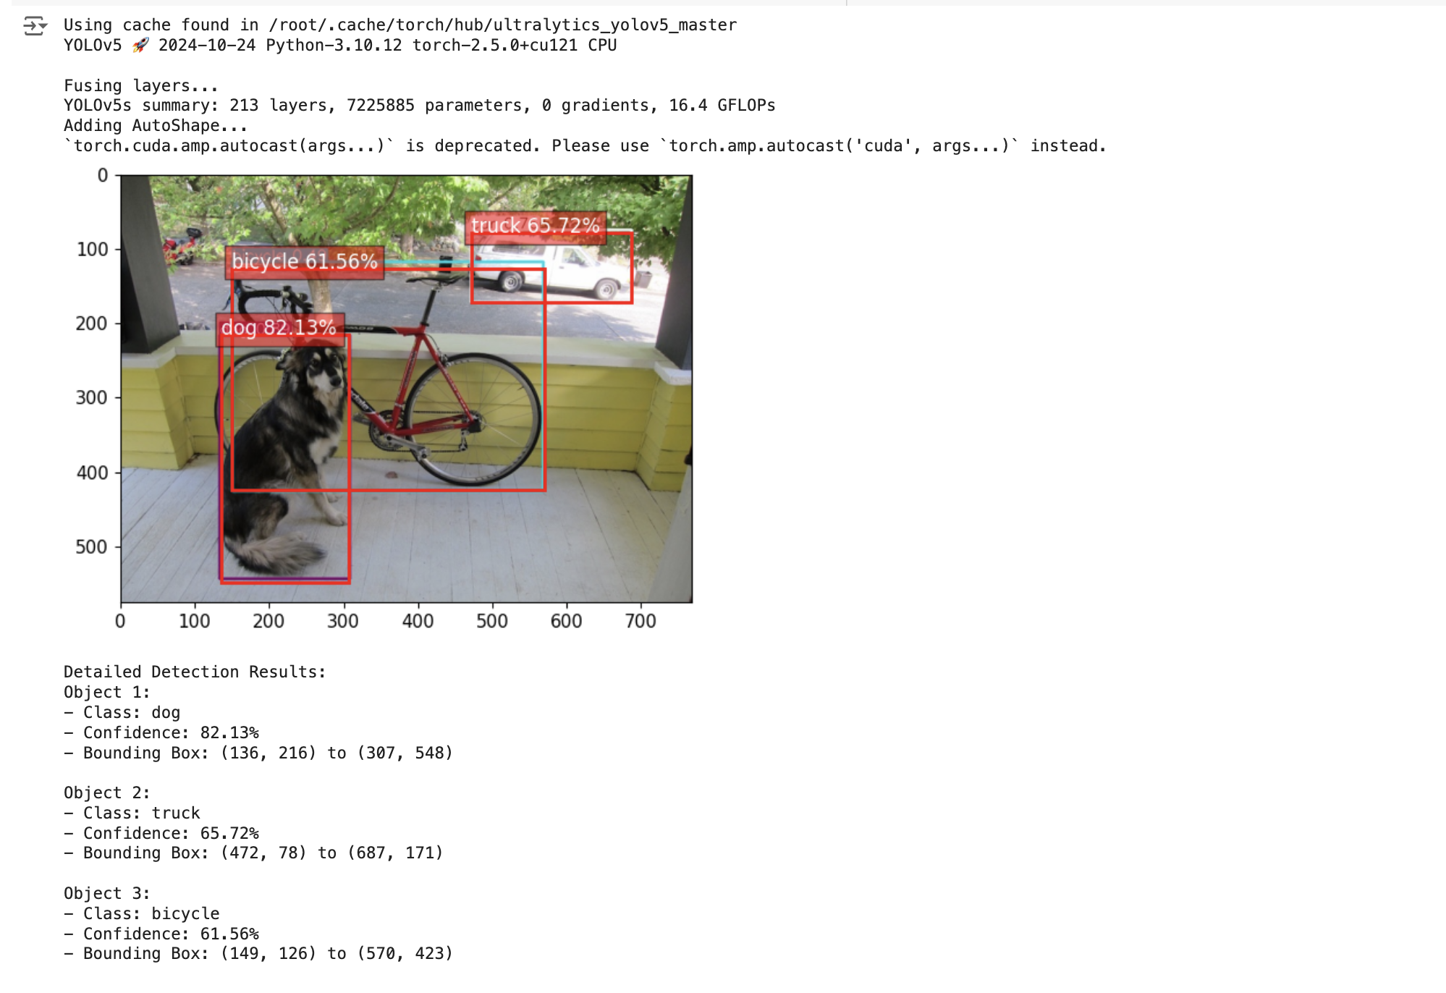
Save image and run prediction on Image Detection

Slide 19
TIPS!
Always check GPU availability: Runtime → Change runtime type → GPU Save your work frequently to Google Drive
Use !pip list to check installed packages
Clear output if notebook becomes too large: Runtime → Restart and run all
Keep your API key secure and never share it in your notebook
If you're sharing your notebook, remove the API key before sharing

Slide 20
Common Issues
GPU not available Check runtime type
Wait and try again later
Memory issues Restart runtime
Clear output
Reduce batch size/image size
Package conflicts Restart runtime
Install packages in correct order
API Key Issues Verify key is correctly copied
Check if key has necessary permissions
Generate a new key if needed

Slide 21
Additional Resources
Google Colab Documentation
YOLOv5 Documentation
Roboflow Documentation
Roboflow API Reference

Slide 22

This Photo by Unknown Author is licensed under CC BY-SA-NC

